Slide 1

Introduction to Machine Learning
Team Project
Project title: Boston Housing Price Prediction
Train the Trainer Program for VN2023

Slide 2
Agenda
Introduction
Project Goals
Project Description
High-level Architecture & Pipeline
ML Models
Technologies
Experiment & Results
Demo
Lesson Learned
Q&A
Train the Trainer Program for VN2023

Slide 3
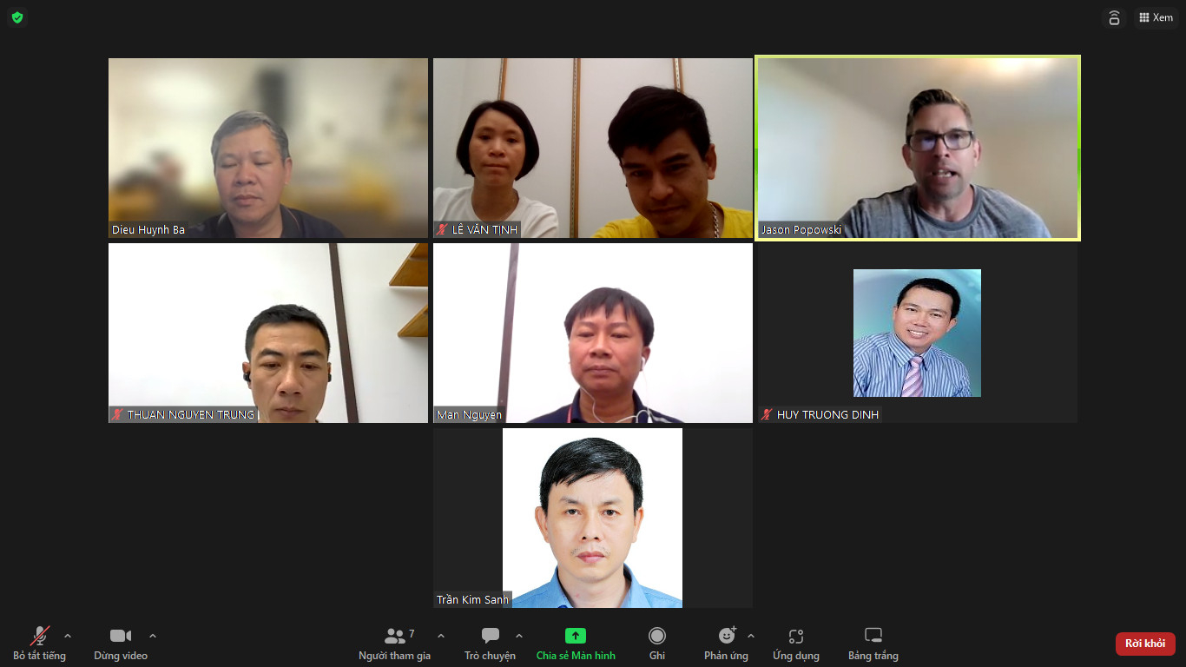
1. Team Introduction
Dieu
Trinh
Tinh
Mentor: Jason
Thuan
Man
Sanh
Mr. Dieu
  Team lead, ML models
Mr. Thuan, Mr. Tinh
  Infrastructures: AWS, EC2, git, deploy web app
Mr. Man
Architecture, Pipeline, MLs, Presentation
Mr. Sanh, and Mr. Thuan
Web App Development, MLs
Ms. Trinh
Testing, Docs, MLs
Train the Trainer Program for VN2023

Slide 4
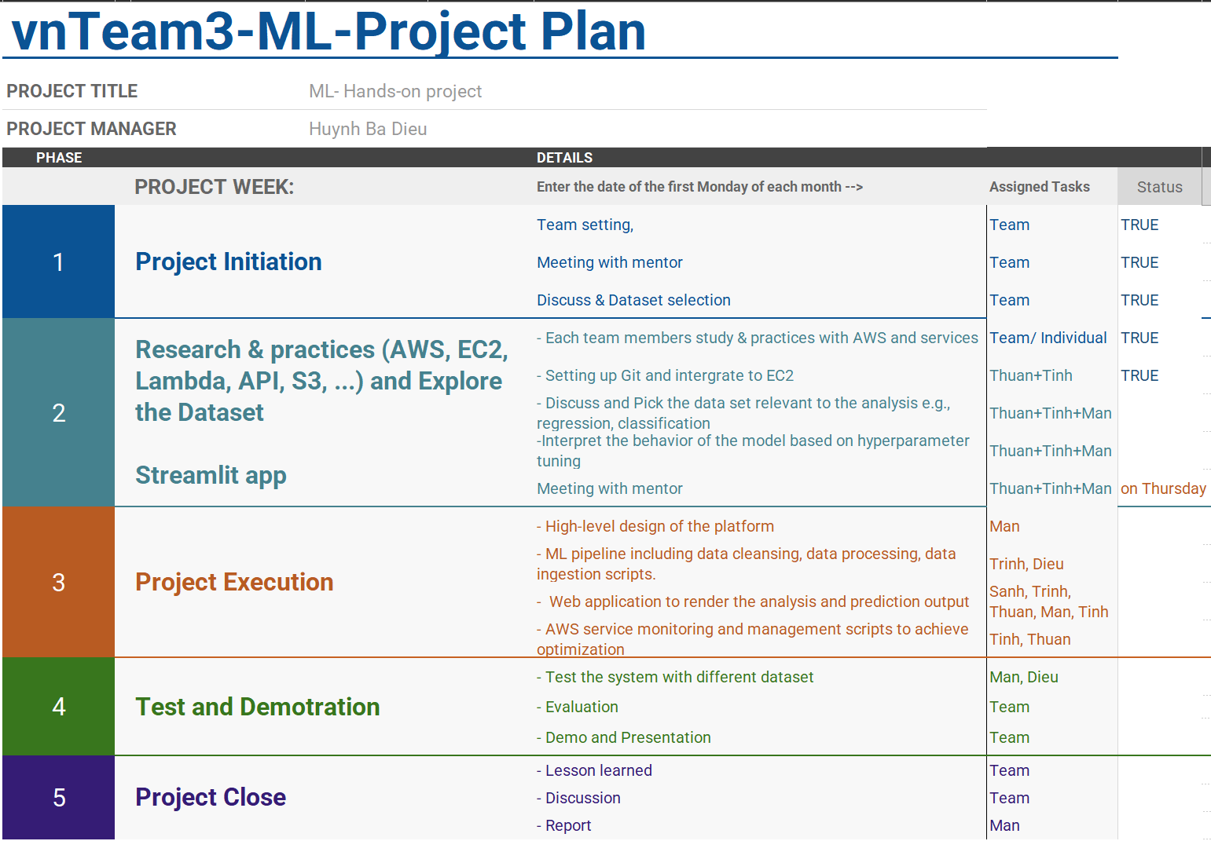

Slide 5
1. Introduction (2)
  AI/ML is becoming increasingly important in the real estate market.
  AI/ML can help in automating various tasks such as property valuation, lead generation, and customer service.
  AI can analyze large amounts of data to determine the value of a property based on various factors such as location, size, and amenities.
  ML algorithms can also be used to identify potential buyers or sellers based on their online behavior and preferences.
  => Housing price prediction assists buyers, sellers, and real estate agents in making informed decisions.
Train the Trainer Program for VN2023

Slide 6
2. Project Goals
Goals of Project
  Building web applications and successfully deploying machine learning models for predicting house prices in Boston, based on the Boston housing dataset.
  Enable real estate agents to provide data-driven insights to clients.
Goals of team members
  Learn the ML Models and the pipeline to implement MLs
  Demonstrate how to deploy the ML project in the real environment using many related technologies (AWS, Git, Python, …)
  Learn the way to apply those activities / deliver the course at our university efficiently.
Train the Trainer Program for VN2023

Slide 7
3. Project Description
Build a machine learning model to predict housing prices based on various features.
  Dataset: Boston Housing Dataset (link http://lib.stat.cmu.edu/datasets/boston )
  Preprocessing: handling missing values, and outlier removal.
  Exploring datasets and visualizing the data
  Predicting the price of housing based on user input data.
The Boston Housing dataset contains information about various features of houses in Boston.
It includes attributes such as per capita crime rate, proportion of residential land zoned for lots over 25,000 sq.ft., average number of rooms per dwelling, etc.
The target variable is the median value of owner-occupied homes in thousands of dollars.
The dataset consists of 506 instances and 13 input features.
Train the Trainer Program for VN2023

Slide 8
3. Project Description
There are 14 attributes in each case of the dataset. They are:
CRIM - per capita crime rate by town
ZN - proportion of residential land zoned for lots over 25,000 sq.ft.
INDUS - proportion of non-retail business acres per town.
CHAS - Charles River dummy variable (1 if tract bounds river; 0 otherwise)
NOX - nitric oxides concentration (parts per 10 million)
RM - average number of rooms per dwelling
AGE - proportion of owner-occupied units built prior to 1940
DIS - weighted distances to five Boston employment centres
RAD - index of accessibility to radial highways
TAX - full-value property-tax rate per $10,000
PTRATIO - pupil-teacher ratio by town
B - 1000(Bk - 0.63)^2 where Bk is the proportion of blacks by town
LSTAT - % lower status of the population
MEDV - Median value of owner-occupied homes in $1000's
Train the Trainer Program for VN2023

Slide 9
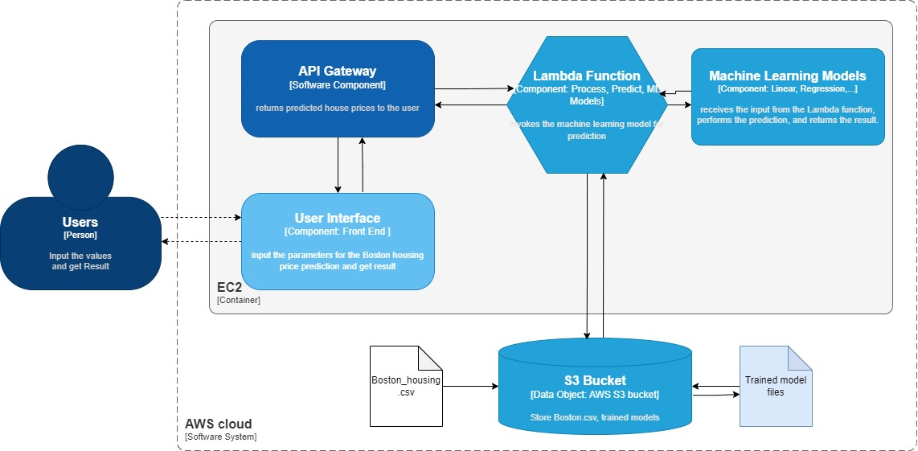
4. High level Architecture
Train the Trainer Program for VN2023

Slide 10
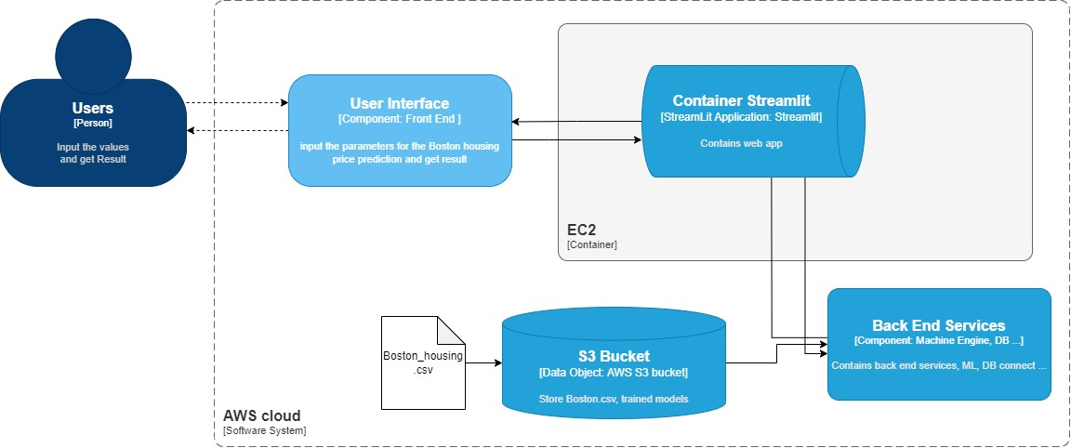
4. High level Architecture (Streamlit Application)

Slide 11
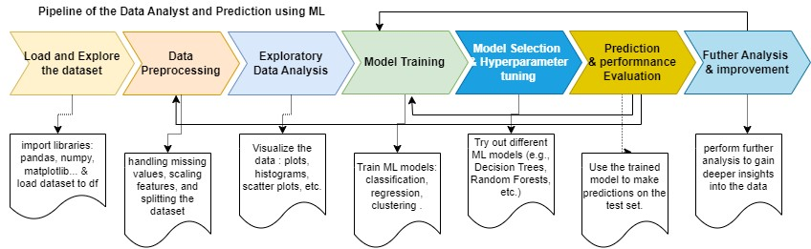
4. Pipeline of Implementing ML Models
Exploring and visualizing: Scatter plot, Histogram, Heatmap
Preprocessing: handling missing values, and outlier removal.
Machine Learning Algorithms Explored: Linear Regression, and Random Forests.
Evaluation Metrics: Mean Squared Error (MSE) and R-squared (R2) score.

Slide 12








6. Technologies

Slide 13
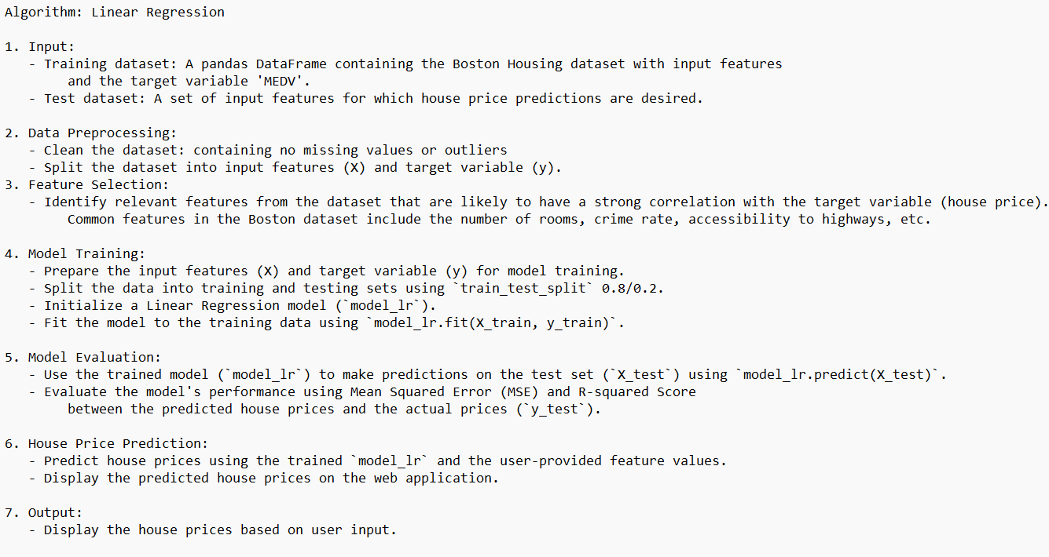
5. Machine learning models

Slide 14
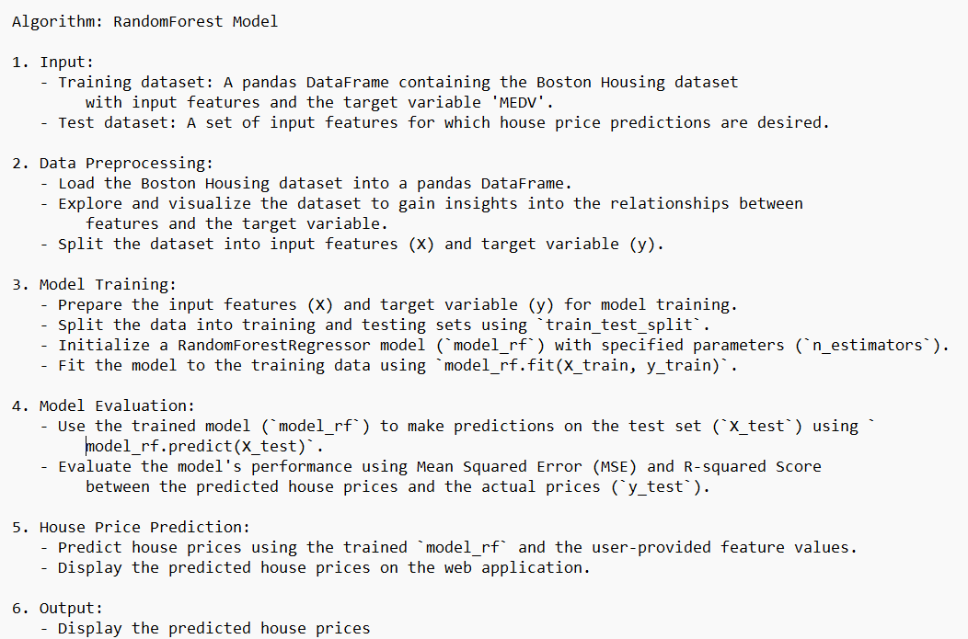
5. Machine learning models

Slide 15
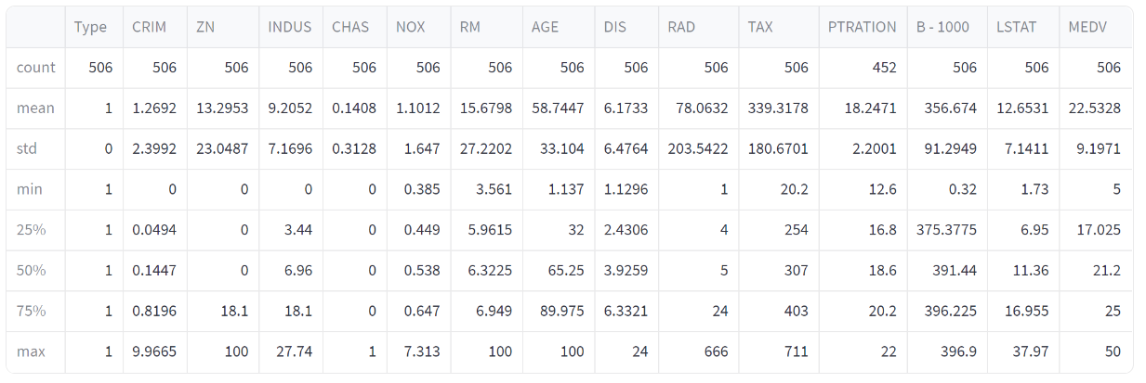
7. Implement & Results
The df.describe() function provides a concise overview of the dataset's numerical features, quickly understand the data distribution, identify potential outliers, and get an overall sense of the range and variability of each feature.

Slide 16
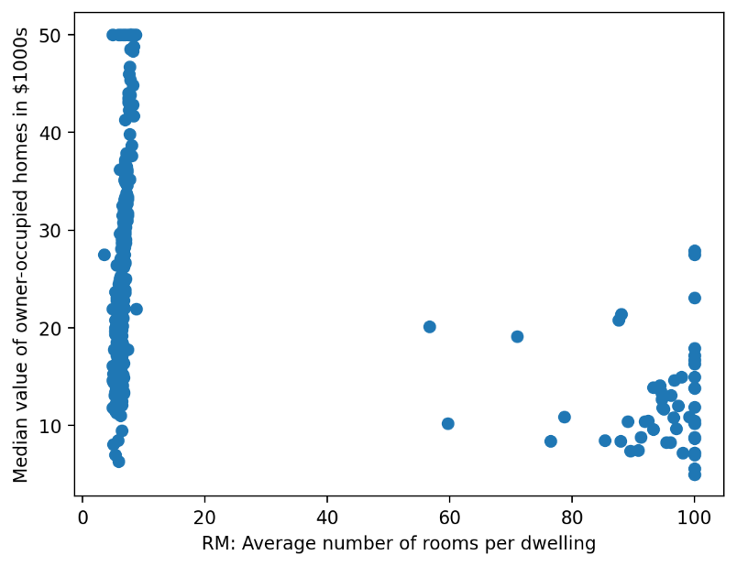
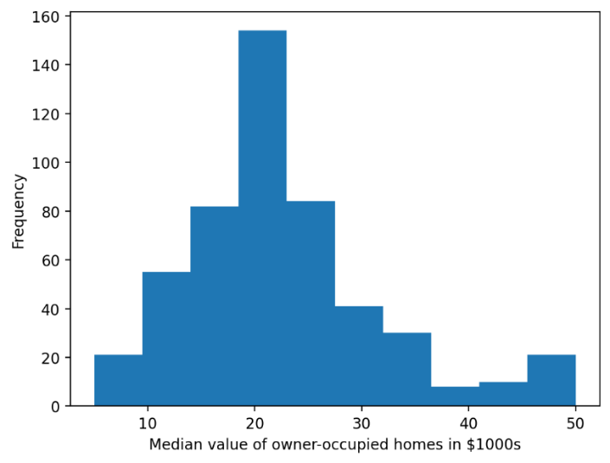
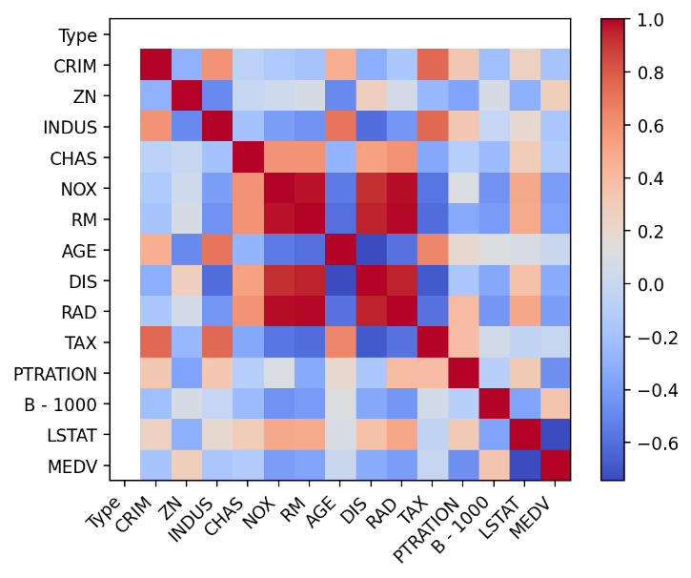
6. Implement & Results

Slide 17
6. Implement & Results
Machine Learning Algorithms Explored: Linear Regression and Random Forests.
Evaluation Metrics: Mean Squared Error (MSE) and R-squared (R2) score.
Results:
  Linear Regression:
    Mean Squared Error: 21.737522829041577
    R-squared Score: 0.7035810523845631
  Random Forests:
    Mean Squared Error: 8.026046029411765
    R-squared Score: 0.890554589119381
Insights: Random Forests outperformed other algorithms with the lowest MSE and highest R2 score.

Slide 18
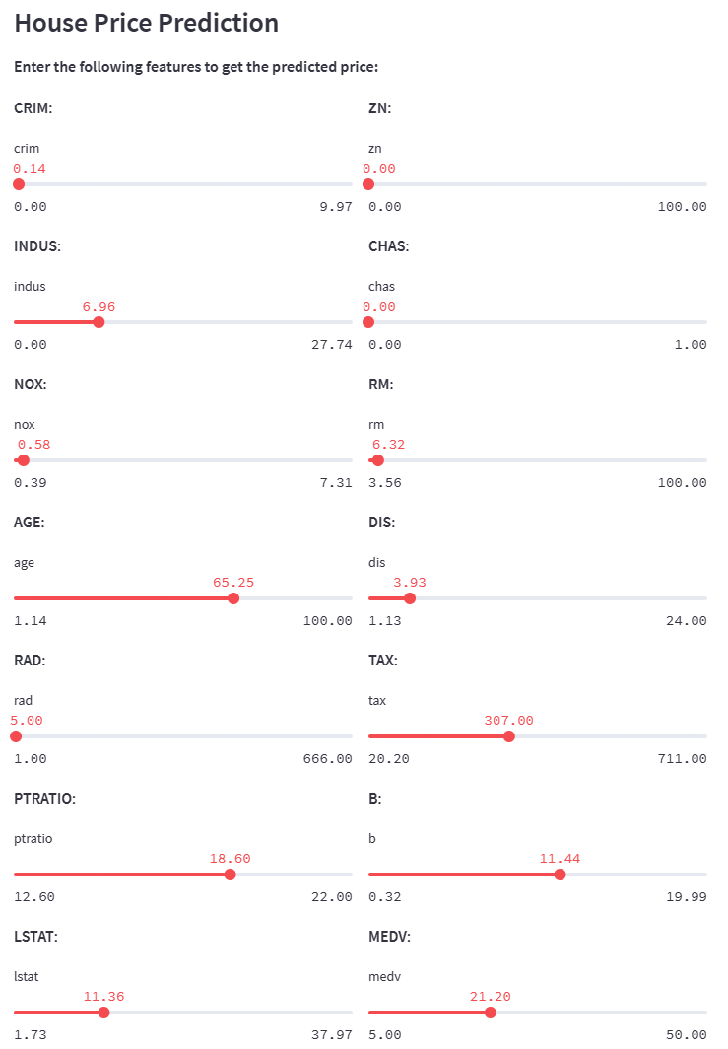
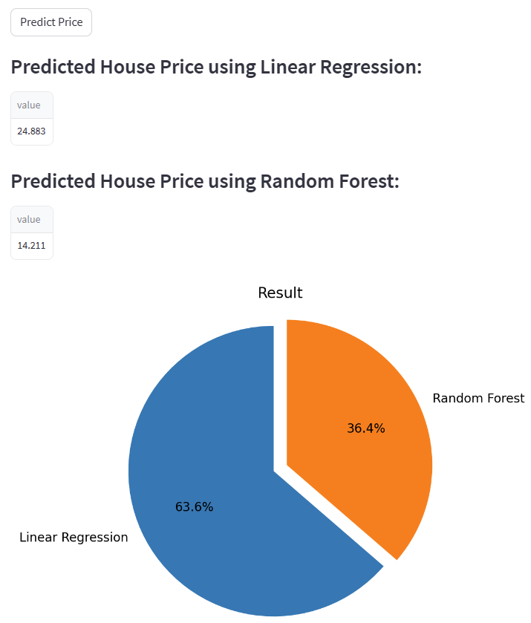
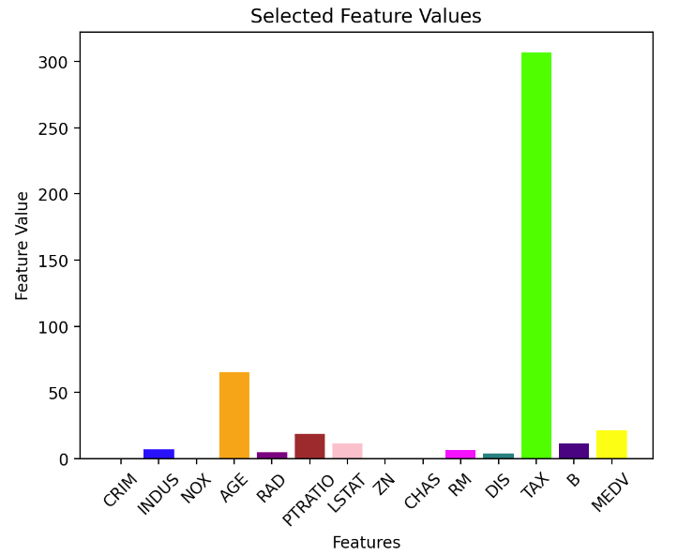

Slide 19

7. Demo
https://team3vncmu-housing-prediction.streamlit.app/

Slide 20
8. Lesson Learned - Things went well
Understanding the Fundamentals of ML concepts and ML algorithms.
Practice some types of Machine Learning Algorithms: Linear Regression, Decision Tree, RandomForest
Understanding and Practicing Data Preprocessing, Model Selection and Evaluation: the methods to evaluate models such as Mean Squared Error, R-squared, và F1-score. Visualizing dataset. Apply the pipeline of Data Analysis.
Use the various technologies AWS, Streamlit, Python, PyCham, Notebooks, Git, …
Demonstrate the “Real-world” Applications: Apply ML Algorithms/ Models that we have learned to solve “the real” problems. (just a small case)
How to / the approach to deliver the course ML to students (lectures/ Quiz, Assignments, team projects, teamwork…)

Slide 21
8. Lesson Learned - Things not went well
ML is indeed a challenge for some team members: Machine Learning (ML) can be a challenge for some team members as it requires specific skills and in-depth knowledge.
We have to research and practice more about clustering, classification, and tuning the performance of the models, etc.,
The deployment of the AWS infrastructure has not been successful.

Slide 22
Thank you very much!
Trân trọng Cảm ơn!

